Slide 1
ME/CFS
Fibromyalgia
Long Covid
Long‑term Conditions
Chronic Pain & Long‑term Conditions
Arthritis / Joint‑related Chronic Pain
Scotland – Support Groups
Pain Association Scotland
Inverness ME / Fibromyalgia / CFS Support Group
Montrose Fibromyalgia Support Group
Fife Fibromyalgia Support Group (Coaltown of Wemyss)
Aberfeldy & Perthshire Fibromyalgia Support Group
Fibromyalgia Friends Scotland (“Fibro Friends”)
Facebook: “Long Covid Support Group : Scotland”
More Than Fibro
UK Long Covid Kids (Scotland rep)
Action for ME
Wigtown FM & Long‑Term Conditions Group
Long Covid Support Scotland (Cheyne Gang)
Versus Arthritis Scotland (Scotland office)
Tayside, Angus & Perthshire Fibromyalgia Support
Edinburgh Fibromyalgia Support Group (ELFS & IMPS)
West Lothian Fibromyalgia Support Group
West Lothian ME Self Help Group (WLMESH)
Falkirk & District Fibromyalgia Support Group
Thistle Foundation (Lifestyle Management / self‑management courses)
Borders ME Group (BMEG)

Slide 2
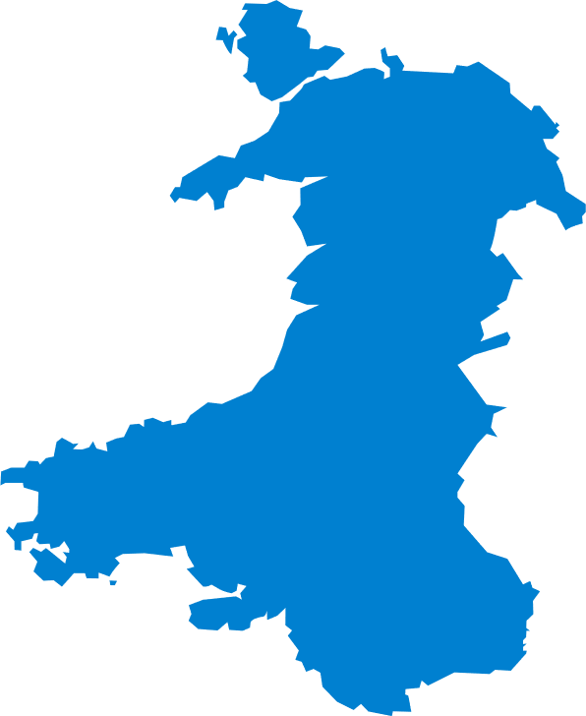
Me/Cfs
Fibromyalgia
Post‑covid / Long Covid Support
Arthritis
Lupus, Gout
Crohn’s Disease & Ulcerative Colitis
Chronic Conditions, Pain Management, Self‑management
Crohn’s disease & ulcerative colitis
Kidney Disease / Chronic Kidney Illness
Wales – Support Groups
Cymru Versus Arthritis – local groups (e.g. Brecon, Swansea, Colwyn Bay, Buckley etc.)
Kidney Care UK – Support Line
Crohn’s & Colitis UK – Wales helpline
Cwm Taf Morgannwg WISE CTM service
FibroSupport – Wales
Aneurin Bevan UHB – Post‑Covid Recovery Service
WAMES (Welsh Association of ME & CFS Support)

Slide 3
Northern Ireland – Support Groups
ME/CFS
Fibromyalgia
Long Covid
Chronic pain conditions
Fibromyalgia Awareness NI (FM.A.NI)
Ballymena Fibromyalgia Support Group
Fibromyalgia Awareness NI (FM.A.NI)
East Belfast Fibromyalgia Support Group
Chronic Pain Survivors NI
Hope 4 ME & Fibro NI
Fibromyalgia Support Northern Ireland (FMSNI)
FSNDA
Long Covid Support Group Northern Ireland (Facebook)
NI Chest Heart & Stroke – Post-COVID Recovery Service
Long Covid Kids
ME Support Northern Ireland (MESNI)
Long Covid Support
Disability Owl Shed Support Team
NI Chest Heart & Stroke – Post-COVID Recovery Service
Lisburn Fibromyalgia Support Group

Slide 4
England– Support Groups
ME/CFS
Fibromyalgia
Long Covid
Peer Partnership Long Covid Peer Support
Sheffield ME & Fibromyalgia Group
Norfolk & Waveney Long Covid & ME/CFS Peer Support Group
Darnall Well Being (Sheffield)
Fibro Flys Support Group
Positive Support Group (Notts)
Fibromyalgia Action UK (national helpline)
Fibromyalgia Friends Together
ME Association (nationwide)
Stevenage Fibromyalgia Support Group (SGFMSG)
Bristol ME Support Group
Keeping Well NWL – Mindfulness group
Action for ME
Long Covid Support (charity HQ)
Salisbury Fibromyalgia Café

Slide 5
Southern Ireland – Support Groups
ME/CFS
Fibromyalgia
Long Covid
ME Advocates Ireland (MEAI)
Long Covid Advocacy Ireland (LCAI)
Donegal Fibromyalgia Support (“Fibromates”)
Irish ME/CFS Association
Dublin Fibromyalgia Support Group (Northside)
Irish M.E. Trust (IMET)
North East Fibromyalgia Support Group
Wexford Fibro Warriors
Carlow Fibromyalgia Support Group
Kerry Fibromyalgia Support Group
Cork Fibromyalgia Support Group

